Slide 1
Abstinence, Contraceptives and STIs
Sexuality, Health and Responsibility Education- 8th Grade

Slide 2
Sex Education for MS Sex, Contraception and STIs

Slide 3
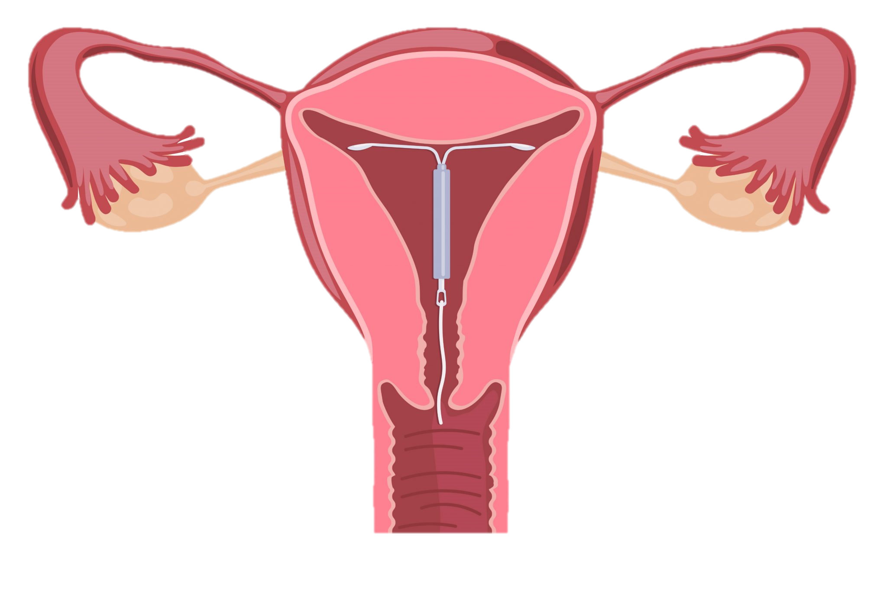
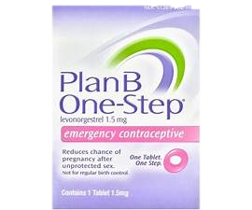
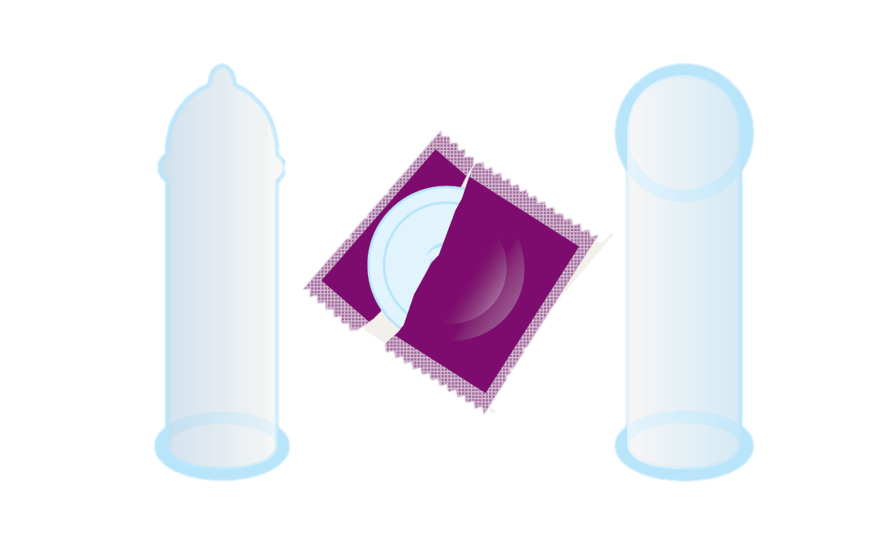
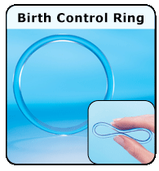
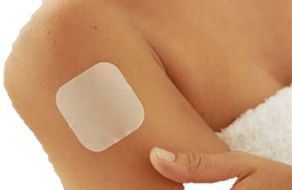
Contraceptives

Slide 4
“consistently and correctly”
Used Every Time without fail!
Used as directed!
Yes, read the directions on the package!

Slide 5
Types of Contraception
PROTECTS RIGHT NOW
Abstinence
External condoms
Internal condoms
Withdrawal
Emergency contraception
Dual Use
PROTECTS FOR A MONTH
Pills/Patch/Ring
Dual Use
PROTECTS FOR A FEW YEARS
IUDs/Shot/Implant
Dual Use

Slide 6
WCSD Definition of Abstinence
Sexual abstinence is defined as refraining from all forms of sexual activity and genital contact such as vaginal, oral and anal sex.
An abstinent person is someone who has either never had sex or someone who's had sex but who has decided not to continue having sex for a period of time.
Abstinence is the only 100% effective way to prevent sexually transmitted HIV, other sexually transmitted diseases or infections and pregnancy.
Sex – when a person’s genitals touch another person’s genitals, mouth or anus.

Slide 7
Condom Dos and Don’ts
DO use a condom every time you have sex.
DO put on a condom before having sex.
DO read the package and check the expiration date.
DO make sure there are no tears or defects.
DO store condoms in a cool, dry place.
DO use latex or polyurethane condoms.
DO use water-based or silicone-based lubricant to prevent breakage.
DON’T store condoms in your wallet as heat and friction can damage them.
DON’T use nonoxynol-9 (a spermicide), as this can cause irritation.
DON’T use oil-based products like baby oil, lotion, petroleum jelly, or cooking oil because they will cause the condom to break.
DON’T use more than one condom at a time.
DON’T reuse a condom.
https://www.cdc.gov/condomeffectiveness/male-condom-use.html

Slide 8
True or False

Slide 9
Abstinence
Abstinence, if used consistently and correctly, is 100% effective at preventing pregnancy.
True!
Abstaining from vaginal, oral, and anal sex can also protect against STIs.
TRUE!

Slide 10
External Condoms
Condoms, if used consistently and correctly, are 98% effective at preventing pregnancy
TRUE!
You must be 16 years old to purchase condoms
FALSE!
Condoms can be legally bought from any store at any age. While they may be placed behind a counter, anyone at any age is legally allowed to buy condoms.

Slide 11
Internal condoms
Internal condoms protect from unplanned pregnancy and STIs when worn consistently and correctly.
TRUE!
Internal and external condoms can be used together.
FALSE!- They can NOT be used together
Internal condoms can be put in ahead of time (unlike the external condom)
TRUE!

Slide 12
Pills/Patch/Ring
The pill, patch and ring can help reduce menstrual cramps and make menstrual periods shorter.
TRUE!
The pill, patch and ring, if used consistently and correctly, are each 99% effective at preventing pregnancy.
TRUE!
The pill, patch and ring, if used consistently and correctly, are also really effective at preventing STIs
FALSE-
the pill, patch and ring only provide protection from pregnancy but do not provide any protection against STIs So using a condom along with one of these methods will help increase the protection against pregnancy and protect against STIs.)

Slide 13
Withdrawal
Withdrawal or pulling out, prevents most STIs.
FALSE– Since withdrawal does not prevent skin-to-skin touching or fluid exchange, if one person is infected with an STI it can still be passed to their partner even if they used withdrawal perfectly.)
Withdrawal is more effective at preventing pregnancy than doing nothing if someone has unprotected sex.
TRUE!
Pre-ejaculatory fluid (or “precum”), which comes out of a penis when it is erect, may contain some sperm. Withdrawal cannot prevent this “pre-cum” from getting inside a vagina.
TRUE!

Slide 14
Dual Use
Dual use generally means using a condom in addition to another method of birth control for STI and pregnancy prevention.
TRUE!
A person would need to get a health care providers permission before they used dual use with their partner.
FALSE
Dual use is something two people can decide on their own if they want to increase their protection.

Slide 15
Emergency Contraception
Anyone of any age can buy emergency contraception from a drugstore like Target, CVS, Rite Aid or Walgreens.
TRUE!
The sooner after unprotected vaginal sex a person takes emergency contraception, the more effective it is. It must be taken within five days after unprotected sex.
TRUE! -within 24 hours of unprotected sex is the most effective
Emergency contraception works by forming a barrier in the fallopian tube which prevents sperm from passing through.
FALSE!-
Emergency contraception works mostly by telling the ovaries to not let any eggs out and sometimes by preventing the egg from being fertilized.)

Slide 16
Need to know… emergency contraception
Emergency contraceptive pills- most effective taken ASAP
Within 24 hours after unprotected sex – 95% effective
48 hours after unprotected sex – 85% effective
72 hours after unprotected sex – 58% effective
Copper IUD- can be inserted (by a health care provider) within 5 days of unprotected sex.

Slide 17
Sexually Transmitted Infections-STIs

Slide 18
Sexually Transmitted infection (STI) or sexually Transmitted Disease (STD)
The terms are used interchangeably
Most would say an STD describes a condition with visible signs and describable symptoms- an itch, drip, bump, fatigue,
STI covers a broader spectrum of conditions both with or without symptoms.

Slide 19
What are sexually transmitted Infections (STI)?
STIs are infections that are passed from one person to another through sexual contact. These include chlamydia, gonorrhea, genital herpes, human papillomavirus (HPV), syphilis, and HIV. Many of these STIs do not show symptoms for a long time. Even without symptoms, they can still be harmful and passed on during sex.
Left untreated, can have long term effects on your body.
Trouble getting pregnant, neurological deficits (syphilis)
https://www.cdc.gov/std/general/default.htm

Slide 20
How are STIs spread?
You can get an STI by having vaginal, anal or oral sex with someone who has an STI.
Anyone who is sexually active can get an STI.
You don’t even have to have anal or vaginal sex to get an STI.
This is because some STIs, like herpes and HPV, are spread by skin-to-skin contact.

Slide 21
Sexually Transmitted Diseases
https://www.cdc.gov/std/products/youth-sti-infographic.pdf
Notes:
Note that young people between 15-24 make up just 24% of the sexually active population, but account for 50% of the 20 million new STIS in the US each year.

Slide 22
STis in Nevada

Slide 23
STIs
Bacterial (curable)
Viral (treatable)
Chlamydia
Gonorrhea
Syphilis
Genital Herpes (HSV)
Genital Warts (HPV)
Hepatitis B ( HBV)
HIV
Hepatitis C (HCV)
Reportable to the Health District- means the health district collects data on these STIs
https://www.washoecounty.us/health/faq/cchs/teen-health-mall/index.php
Notes:
Curable with antibiotics.
Treatable-treat the symptoms, but disease is not curable.

Slide 24
How could you find out if your partner has an STI?
Ask them and suggest getting tested together before engaging in any sexual activity.
Notes:
Probe for: Ask the person(remind students that many STDs have no symptoms so they might not know they have one)

Slide 25
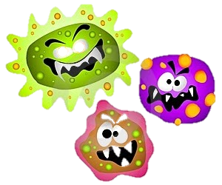
Ways to Reduce or Eliminate Your Risk…
Abstinence means different things to different people and
partners need to communicate that
Before abstinence or safer sex comes…
Safer sex is a negotiation between partners
Knowing your partners disease status
Notes:
It’s very important to make sure both partners have expressed their own personal definitions of abstinence.

Slide 26
Where to go for testing
GetTested
National HIV, STD, and Hepatitis Testing
Find free, Fast, and Confidential Testing Near You

Slide 27
Who to talk to…
Parent or Guardian
Trusted adult
Faith based leader
Teacher
School Counselor
School Nurse
Health Clinic
Health care provider

Slide 28
Local Resources- Please take a picture for future reference
Washoe County Health District:
Teen Health Mall/Clinic 775-328-2470
Northern Nevada HOPES:775-786-4673
Planned Parenthood of Northern Nevada: 775-688-5555
Crisis Call Center: text “listen” to 839863
Suicide Prevention Lifeline: 1-800-273-8255
LGBTQ+ Friendly Services: https://www.nnhopes.org/patients/services/lgbtq/

Slide 29
Exit Ticket
List 3 ways an STI can be spread from one person to another.
If you were to find out you had an STI, what could you do to make sure you don’t pass it to someone else?
Explain why the following three strategies can be the most effective way to protect yourself or someone else from getting an STI.
Abstinence
Using condoms/barrier methods correctly each time you have sex
Getting tested for STIs(and making sure your partner does too) before you have sex together.

